Slide 1
UNIT-1 Introducing Big Data, Hadoop, and Spark
School of Computer Science and Engineering
AY: 2024-2025

Slide 2
Introduction to bigdata
A Brief History of Big Data and Hadoop
The search engine providers were the first group of users faced with Internet scale problems, Mainly how to process and store indexes of all the documents in the Internet universe Yahoo! and Google independently set about developing a set of capabilities to meet this challenge.
In 2003, Google released a whitepaper titled “The Google File System.” Subsequently, in 2004, Google released another whitepaper, titled “MapReduce: Simplified Data Processing on Large Clusters.” Around the same time, Doug Cutting, who is generally acknowledged as the initial creator of Hadoop, and Mike Cafarella were working on a web crawler project called Nutch, which was based on Cutting’s open source Lucene project (now Apache Lucene)
The Google whitepapers inspired Cutting to take the work he had done on the Nutch project and incorporate the storage and processing principles outlined in these whitepapers. The resulting product is what we know today as Hadoop. Later in 2006, Yahoo! decided to adopt Hadoop and hire Doug Cutting to work full time on the project. Hadoop joined the Apache Software Foundation in 2006.

Slide 3
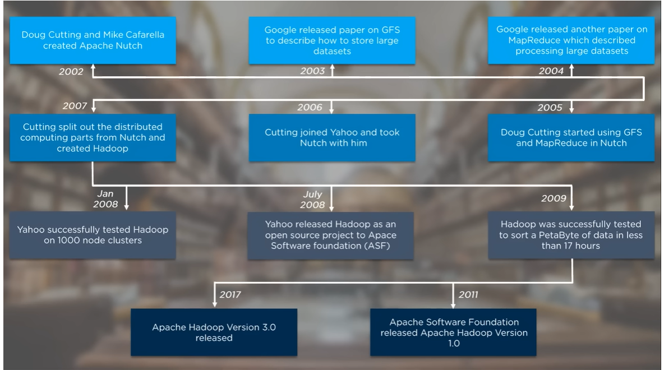

Slide 4
Hadoop
Hadoop is a data storage and processing platform initially based on a central concept:
Data Locality-Data locality refers to the pattern of processing data where it resides by bringing the computation to the data rather than the typical pattern of requesting data from its location.
For example, a database management system—and sending the data to a remote processing system or host.
Hadoop enables large datasets to be processed locally on the nodes of a cluster using a shared nothing approach, where each node can independently process a much smaller subset of the entire dataset without needing to communicate with other nodes

Slide 5
Introduction to Big Data
Core Components of Hadoop
Hadoop has two core components:
HDFS (Hadoop Distributed File System) and YARN (Yet Another Resource Negotiator).
HDFS is Hadoop’s storage subsystem, whereas YARN can be thought of as Hadoop’s processing, or resource scheduling, subsystem

Slide 6
Introduction to Big Data
HDFS: Files, Blocks, and Metadata
HDFS is a virtual filesystem where files are composed of blocks distributed across one or more nodes of the cluster.
Files are split indiscriminately, according to a configured block size upon uploading data into the filesystem, in a process known as ingestion.
The blocks are then distributed and replicated across cluster nodes to achieve fault tolerance and additional opportunities for processing data locally (the design goal of “bringing the computation to the data”).
HDFS blocks are stored and managed on a slave node in HDFS cluster process called the DataNode.

Slide 7
Introduction to Big Data

Slide 8
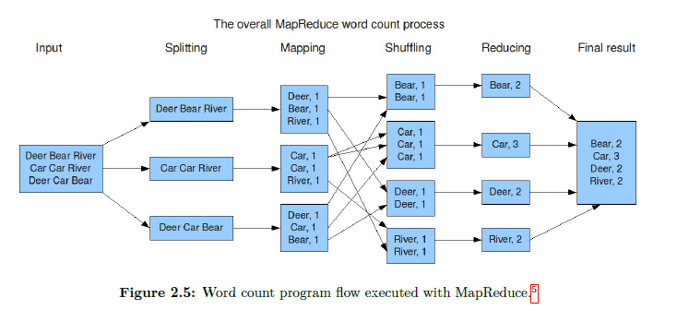
Fig. Word count program flow executed with MapReduce.

Slide 9
Introduction to Big Data
Anatomy of an HDFS read operation

Slide 10
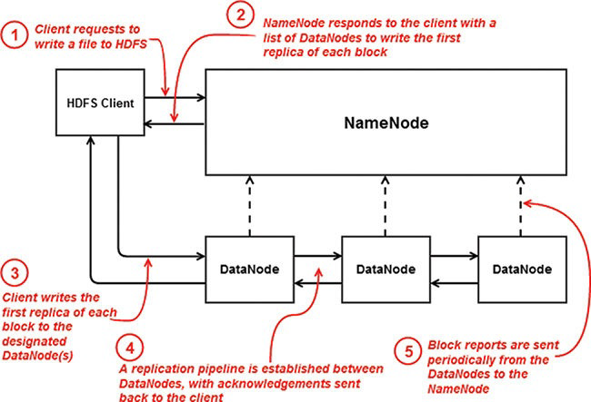
Introduction to Big Data
Anatomy of an HDFS write operation

Slide 11
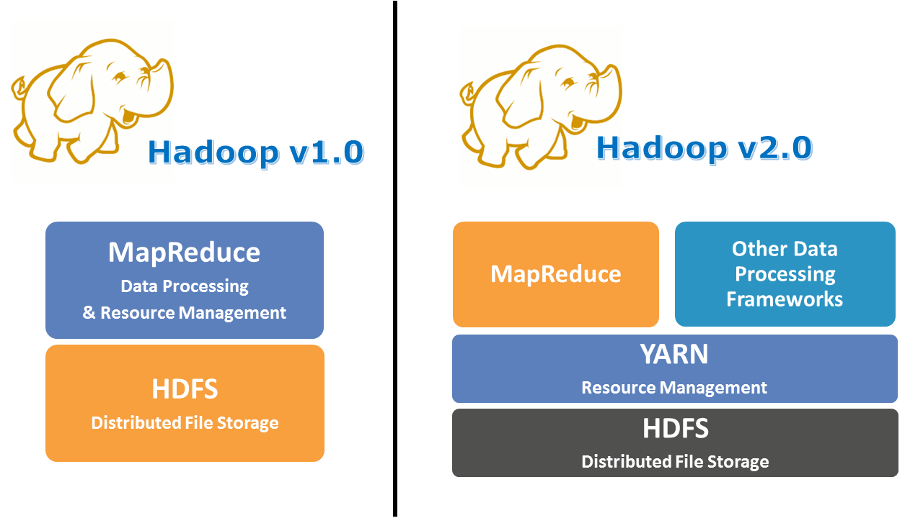

Slide 12
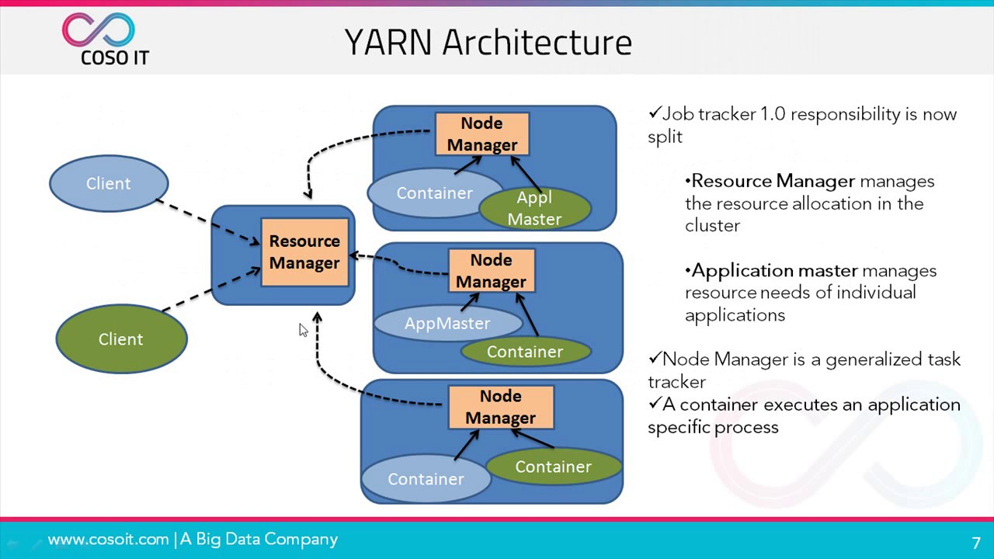

Slide 13
Introduction to Big Data
Application Scheduling Using YARN
YARN governs and orchestrates the processing of data in Hadoop, which usually is data sourced from and written to HDFS. The YARN cluster architecture is a master/slave cluster framework like HDFS, with a master node daemon called the ResourceManager and one or more slave node daemons called NodeManagers running on worker, or slave, nodes in the cluster.
The Resource Manager is responsible for granting cluster compute resources to applications running on the cluster. Resources are granted in units called containers, which are predefined combinations of CPU cores and memory.
Clients submit applications, such as Spark applications, to the ResourceManager; the Resource Manager then allocates the first container on an available NodeManager in the cluster as a delegate process for the application called the ApplicationMaster; the Application Master then negotiates all further containers required to run tasks for the application.

Slide 14
Introduction to Big Data
YARN ResourceManager user interface

Slide 15
Introduction to Big Data
YARN application submission, scheduling, and execution

Slide 16
Introduction to Big Data
The process works as follows:
A client submits an application to the ResourceManager.
The ResourceManager allocates an ApplicationMaster process on a NodeManager with sufficient capacity to be assigned this role. The ApplicationMaster negotiates task containers
ResourceManager to be run on NodeManagers—which can include the NodeManager on which the ApplicationMaster is running as well—and dispatches processing to the NodeManagers hosting the task containers for the application.
The NodeManagers report their task attempt status and progress to the ApplicationMaster.
The ApplicationMaster reports progress and the status of the application to the ResourceManager.
The ResourceManager reports application progress, status, and results to the client.

Slide 17
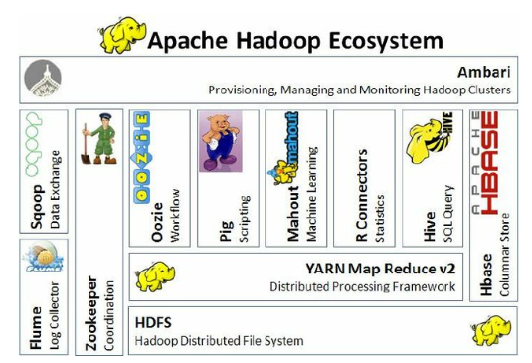

Slide 18
Introduction to Apache Spark

Slide 19
Introduction to Spark
Apache Spark Background
Apache Spark is an open source distributed data processing project started in 2009 by Matei Zaharia at the University of California, Berkeley, RAD Lab. Spark was created as part of the Mesos research project, designed to look at an alternative resource scheduling and orchestration system to MapReduce.
As an alternative to MapReduce, Spark implements a distributed, fault-tolerant, in-memory structure called a Resilient Distributed Dataset (RDD). Spark maximizes the use of memory across multiple machines, significantly improving overall performance.
Spark is written in Scala, which is built on top of the Java Virtual Machine (JVM) and Java runtime. This makes Spark a cross-platform application capable of running on Windows as well as Linux.

Slide 20
Introduction to Spark
Introduction to Apache Spark
Apache Spark was created as an alternative to the implementation of MapReduce in Hadoop to gain efficiencies measured in orders of magnitude.
Spark also delivers unrivaled extensibility and is effectively a Swiss Army knife for data processing, delivering SQL access, streaming data processing, graph and NoSQL processing, machine learning, and much more.

Slide 21
Introduction to Spark
Uses for Spark
Extract-transform-load (ETL) operations
Predictive analytics and machine learning
Data access operations, such as SQL queries and visualizations
Text mining and text processing
Real-time event processing
Graph applications
Pattern recognition
Recommendation engines

Slide 22
Introduction to Spark
Differences between Hadoop and Spark
Basis | Hadoop | Spark
Processing Speed & Performance | Hadoop’s MapReduce model reads and writes from a disk, thus slowing down the processing speed. | Spark reduces the number of read/write cycles to disk and stores intermediate data in memory / RAM, hence faster-processing speed.
Usage | Hadoop is designed to handle batch processing efficiently. | Spark is designed to handle real-time data efficiently.
Latency | Hadoop is a high latency computing framework, which does not have an interactive mode. | Spark is a low latency computing and can process data interactively.
Data | With Hadoop MapReduce, a developer can only process data in batch mode only. | Spark can process real-time data, from real-time events like Twitter, and Facebook.
Cost | Hadoop is a cheaper option available while comparing it in terms of cost | Spark requires a lot of RAM to run in-memory, thus increasing the cluster and hence cost.
Algorithm Used | The PageRank algorithm is used in Hadoop. | Graph computation library called GraphX is used by Spark.

Slide 23
Introduction to Spark
Differences between Hadoop and Spark
Basis | Hadoop | Spark
Fault Tolerance | Hadoop is a highly fault-tolerant system where Fault-tolerance achieved by replicating blocks of data. If a node goes down, the data can be found on another node | Fault-tolerance achieved by storing chain of transformations, If data is lost, the chain of transformations can be recomputed on the original data.
Security | Hadoop supports LDAP, ACLs, SLAs, etc and hence it is extremely secure. | Spark is not secure, it relies on the integration with Hadoop to achieve the necessary security level.
Machine Learning | Data fragments in Hadoop can be too large and can create bottlenecks. Thus, it is slower than Spark. | Spark is much faster as it uses MLib for computations and has in-memory processing.
Scalability | Hadoop is easily scalable by adding nodes and disk for storage. It supports tens of thousands of nodes. | It is quite difficult to scale as it relies on RAM for computations. It supports thousands of nodes in a cluster.

Slide 24
Introduction to Spark
Programming Interfaces to Spark
Spark is written in Scala, and it runs in JVMs. Spark provides native support for programming interfaces including the following:
Scala
Python (using Python’s functional programming operators)
Java
SQL
R

Slide 25
Introduction to Spark
Submission Types for Spark Programs
Spark programs can run
Interactive
Non-Interactive
Interactive programming shells are available in Python and Scala.
Interactive R and SQL shells are included with Spark as well

Slide 26
Introduction to Spark
PySpark shell

Slide 27
Introduction to Spark
Scala shell

Slide 28
Introduction to Spark
Non-interactive or Batch Submission
Non-interactive applications can be submitted using the spark-submit command,
as shown below
$SPARK_HOME/bin/spark-submit \
--class org.apache.spark.examples.SparkPi \
--master yarn-cluster \
--num-executors 4 \
--driver-memory 10g \
--executor-memory 10g \
--executor-cores 1 \
$SPARK_HOME/examples/jars/spark-examples*.jar 10

Slide 29
Introduction to Spark
Input/Output Types for Spark Applications
Local or network filesystems
Object storage such as Amazon S3 or Ceph
Relational database systems
NoSQL stores, including Cassandra, HBase, and others
Messaging systems such as Kafka

Slide 30
Introduction to Spark
The Spark RDD
Spark Resilient Distributed Dataset (RDD) the primary data abstraction structure for Spark applications, is one of the main differentiators between Spark and other cluster computing frameworks.
Spark RDDs can be thought of as in-memory collections of data distributed across a cluster.
Spark programs using the Spark core API consist of loading input data into an RDD, transforming the RDD into subsequent RDDs, and then storing or presenting the final output for an application from the resulting final RDD.

Slide 31
Introduction to Spark
HDFS as a Data Source for Spark
Spark can be deployed as a processing framework for data in Hadoop, typically in HDFS.
Spark has built-in support for reading and writing to and from HDFS in various file formats such as
Native text file format
Sequence file format
Parquet format

Slide 32
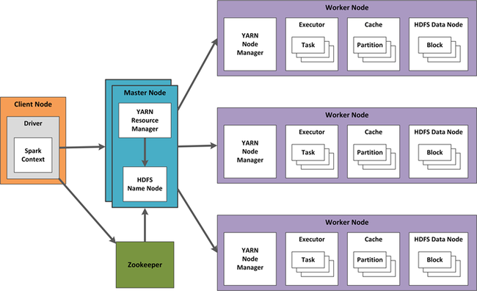
Introduction to Spark
YARN as a Resource Scheduler for Spark
YARN is one of the most commonly used process schedulers for Spark applications. Because YARN is usually collocated with HDFS on Hadoop clusters, YARN is a convenient platform for managing Spark applications.

Slide 33
Functional Programming Using Python

Slide 34
Introduction to Spark
Python is an amazingly useful language.
It uses range from automation to web services to machine learning and everything in between.
Python has risen to be one of the most widely used languages today.
Python combines imperative (functions are implicitly coded) and procedural programming paradigms with full support for the object-oriented and functional paradigms.

Slide 35
Introduction to Spark
Data Structures Used in Functional Python Programming
Lists
Lists in Python are zero-based indexed sequences of mutable values with the first value numbered zero.
You can remove or replace elements in a list as well as append elements to the end of a list.
>>> tempc = [38.4, 19.2, 12.8, 9.6]
>>> print(tempc[0])
38.4
>>> print(len(tempc))
4

Slide 36
Introduction to Spark
Importantly, lists support the three primary functional programming constructs —map(), reduce(), and filter()—as well as other built-in methods, including count(), sort(), and more
Python map() Function
>>> tempc = [38.4, 19.2, 12.8, 9.6]
>>> tempf = list(map(lambda x: (float(9)/5)*x + 32, tempc) )
>>> tempf
[101.12, 66.56, 55.040000000000006, 49.28]

Slide 37
Introduction to Spark
Tuples
Tuples are an immutable sequence of objects, though the objects contained in a tuple can themselves be immutable or mutable. Tuples can contain different underlying object types, such as a mixture of string, int, and float objects, or they can contain other sequence types, such as sets and other tuples.
>>> rec0 = "Jeff", "Aven", 46
>>> rec1 = "Barack", "Obama", 54
>>> rec2 = "John F", "Kennedy", 46
>>> rec3 = "Jeff", "Aven", 46
>>> rec0
('Jeff', 'Aven', 46)
>>> len(rec0)
3
>>> print("first name: " + rec0[0])
first name: Jeff

Slide 38
# create tuple of tuples
>>> all_recs = rec0, rec1, rec2, rec3
>>> all_recs
(('Jeff', 'Aven', 46), ('Barack', 'Obama', 54), ('John F', 'Kennedy', 46), ('Jeff', 'Aven', 46))
# create list of tuples
>>> list_of_recs = [rec0, rec1, rec2, rec3]
>>> list_of_recs
[('Jeff', 'Aven', 46), ('Barack', 'Obama', 54), ('John F', 'Kennedy', 46), ('Jeff', 'Aven', 46)]

Slide 39
Introduction to Spark
Dictionaries
Dictionaries, or dicts, in Python are unordered mutable sets of key/value pairs. Dict objects are denoted by curly braces ({}), which you can create as empty dictionaries by simply executing a command such as my_empty_dict = {}.
Unlike with lists and tuples, where an element is accessed by its ordinal position in the sequence (its index), an element in a dict is accessed by its key. A key is separated from its value by a colon (:), whereas key/value pairs in a dict are separated by commas.
Some useful dict methods, including keys(), values(), cmp(), and len().

Slide 40
Introduction to Spark
>>> dict0 = {'fname':'Jeff', 'lname':'Aven', 'pos':'author’}
>>> dict1 = {'fname':'Barack', 'lname':'Obama', 'pos':'president’}
>>> dict2 = {'fname':'Ronald', 'lname':'Reagan', 'pos':'president’}
>>> dict3 = {'fname':'John', 'mi':'F', 'lname':'Kennedy', 'pos':'president’}
>>> dict4 = {'fname':'Jeff', 'lname':'Aven', 'pos':'author’}
>>> len(dict0)
3
>>> print(dict0['fname’]
Jeff

Slide 41
>>> dict0.keys()
['lname', 'pos', 'fname’]
>>> dict0.values()
['Aven', 'author', 'Jeff’]
# compare dictionaries
>>> cmp(dict0, dict1)
1 ## keys match but values dont
>>> cmp(dict0, dict4)
0 ## all key value pairs match
>>> cmp(dict1, dict2)
−1 ## some key value pairs match

Slide 42
Introduction to Spark
Python Object Serialization
Serialization is the process of converting an object into a structure that can be unpacked (deserialized) at a later point in time on the same system or on a different system.
JSON
JSON (JavaScript Object Notation) is a common serialization format. JSON has extended well beyond JavaScript and is used in a multitude of platforms, with support in nearly every programming language. It is a common response structure returned from web services.
JSON is supported natively in Python using the json package. A package is a set of libraries or a collection of modules (which are essentially Python files). The json package is used to encode and decode JSON. A JSON object consists of key/value pairs (dictionaries) and/or arrays (lists), which can be nested within each other

Slide 43
Introduction to Spark
JSON
JSON (JavaScript Object Notation) is a common serialization format.
JSON has extended well beyond JavaScript and is used in a multitude of platforms, with support in nearly every programming language.
It is a common response structure returned from web services.
JSON is supported natively in Python using the json package.
A package is a set of libraries or a collection of modules (which are essentially Python files). The json package is used to encode and decode JSON.
A JSON object consists of key/value pairs (dictionaries) and/or arrays (lists), which can be nested within each other

Slide 44
>>> import json
>>> from pprint import pprint
>>> json_str = '‘’{
... "people" : [
... {"fname": "Jeff",
... "lname": "Aven",
... "tags": ["big data","hadoop"]},
... {"fname": "Doug",
... "lname": "Cutting",
... "tags": ["hadoop","avro","apache","java"]},
... {"fname": "Martin",
... "lname": "Odersky",
... "tags": ["scala","typesafe","java"]},
... {"fname": "John",
... "lname": "Doe",
... "tags": []}
... ]}'‘’
>>> people = json.loads(json_str)
>>> len(people["people"])
4
>>> print(people["people"][0]["fname"]) Jeff
# add tag item to the first person people["people"][0]["tags"].append(u'spark’)
# delete the fourth person
del people["people"][3]

Slide 45
Introduction to Spark
Pickle
JSON can only store basic structures such as a list and dictionary, and it can only keep strings and numbers. We cannot ask JSON to remember the data type (e.g., numpy float32 vs. float64). It also cannot distinguish between Python tuples and lists.
Pickle is a serialization method that is proprietary to Python. Pickle is faster than JSON. However, it lacks the portability of JSON, which is a universally interchangeable serialization format.
cPickle, as the name suggests, is implemented in C instead of Python, and thus it is much faster than the Python implementation.

Slide 46
>>> import cPickle as pickle
>>> obj = { "fname": "Jeff", \
... "lname": "Aven", \
... "tags": ["big data","hadoop"]}
>>> str_obj = pickle.dumps(obj)
>>> pickled_obj = pickle.loads(str_obj)
>>> print(pickled_obj["fname"])
Jeff
>>> pickled_obj["tags"].append('spark’)
>>> print(str(pickled_obj["tags"]))
['big data', 'hadoop', 'spark’]
# dump pickled object to a string
>>> pickled_obj_str = pickle.dumps(pickled_obj)
# dump pickled object to a pickle file
>>> pickle.dump(pickled_obj, open('object.pkl', 'wb'))

Slide 47
Introduction to Spark
Python Functional Programming Basics
Python’s functional support embodies all of the functional programming paradigm characteristics and following.
Functions as first-class objects and the fundamental unit of programming
Functions with input and output only (Statements, which could result in side effects, are not allowed.)
Support for higher-order functions
Support for anonymous functions

Slide 48
Introduction to Spark
Anonymous Functions and the lambda Syntax
Anonymous functions, or unnamed functions, are a consistent feature of functional programming
Anonymous functions in Python are implemented using the lambda construct rather than using the def keyword for named functions. Anonymous functions accept any number of input arguments but return just one value. This value could be another function, a scalar value, or a data structure such as a list.

Slide 49
Introduction to Spark
Named Functions and Anonymous Functions in Python
# named function
>>> def plusone(x):
return x+1
...
>>> plusone(1)
2
>>> type(plusone)
<type ‘function’>
>>> plusone.func_name
'plusone’
# anonymous function
>>> plusonefn = lambda x: x+1
>>> plusonefn(1)
2
>>> type(plusonefn)
<type ‘function’>
>>> plusonefn.func_name
‘<lambda>’
named function plusone keeps a reference to the function name, whereas the anonymous function plusonefn keeps a name reference.

Slide 50
Introduction to Spark
Higher-Order Functions
A higher-order function accepts functions as arguments and can return a function as a result. map(), reduce(), and filter() are examples of higher-order functions.
>>> lines = sc.textFile("file:///opt/spark/licenses")
>>> counts = lines.flatMap(lambda x: x.split(' ')) \
... .filter(lambda x: len(x) > 0) \
... .map(lambda x: (x, 1)) \
... .reduceByKey(lambda x, y: x + y) \
... .collect()
>>> for (word, count) in counts:
... print("%s: %i" % (word, count))

Slide 51
Introduction to Spark
Higher-Order Functions
A higher-order function accepts functions as arguments and can return a function as a result. map(), reduce(), and filter() are examples of higher-order functions.
def loud(text):
Return text:upper()
def hello(func):
Text=func(“Hello”)
Print(text)
Hello(loud)

Slide 52
Introduction to Spark
Closures
Closures are function objects that enclose the scope at the time they were instantiated. This can include any external variables or functions used when the function was created. Closures “remember” the values by enclosing the scope.
>>> def generate_message(concept):
... def ret_message():
... return 'This is an example of ' + concept
... return ret_message
...
>>> call_func = generate_message('closures in Python’)
>>> call_func
<function ret_message at 0x7fd138aa55f0>
>>> call_func()
'This is an example of closures in Python'

